Slide 1
Artificial Neural Network

Slide 2
Agenda
Background and Applications of Neural Networks
Neurons and Nodes
Neural Network Architecture
Logistic Regression Neural Network
Gradient Descent
Training a Neural Network

Slide 3
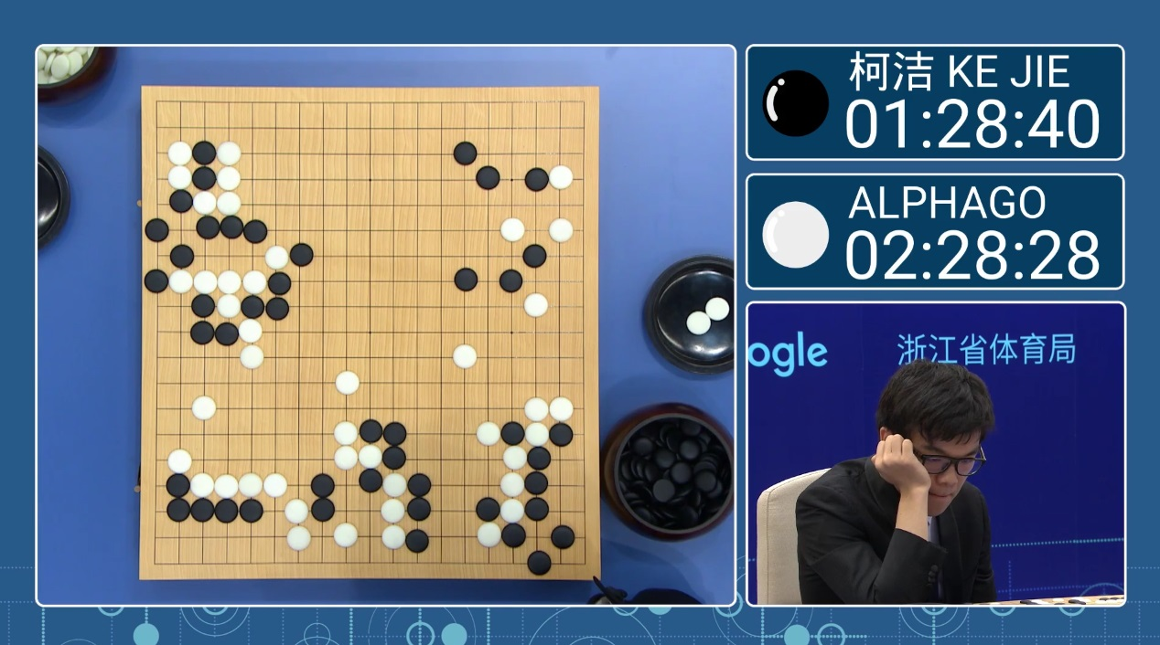
Background and Applications of Neural Networks
Over the past few decades, the digitization of our society has led to massive amounts of data being stored. Combining this increase in the scale of stored information with advances in hardware computational power and algorithmic innovations, the field of artificial intelligence (AI) has jumped into the spotlight as machines seem to possess the ‘magical’ ability to learn without being told explicitly what to do.
Examples of impressive feats performed by machines include: AlphaGo defeating 9dan rank Go champion Lee Sedol, self-driving cars navigating city streets, and a computer learning to beat Super Mario World by itself. At the heart of such systems have been algorithms called deep neural networks that can model the non-linearities inherently present in image, audio, and video data.

Slide 4
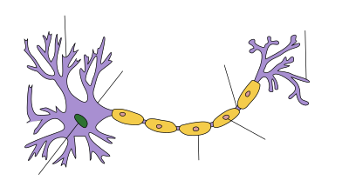
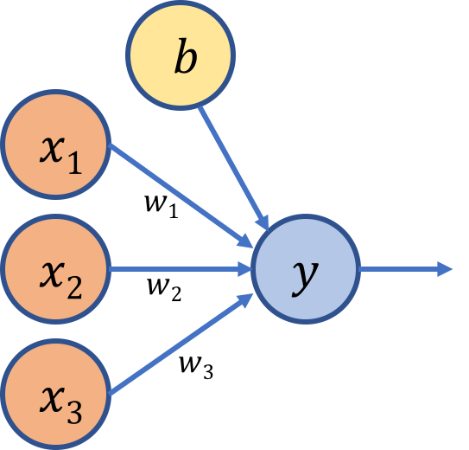
A Neuron
Neural network is a set of neurons organized in layers. Each neuron is a mathematical operation that takes it's input, multiplies it by it's weights and then passes the sum through the activation function to the other neurons.
The neuron in a neural network functions In the same way as a neuron in a human brain does.
This neuron function is defined as a weighted sum of its inputs — multiply the inputs x by variables w called weights to get the output. You can think of weights as the strengths of the connections between input and output.
The value b is called the bias term and is responsible for shifting the function so that it’s not constrained to the origin.

Slide 5
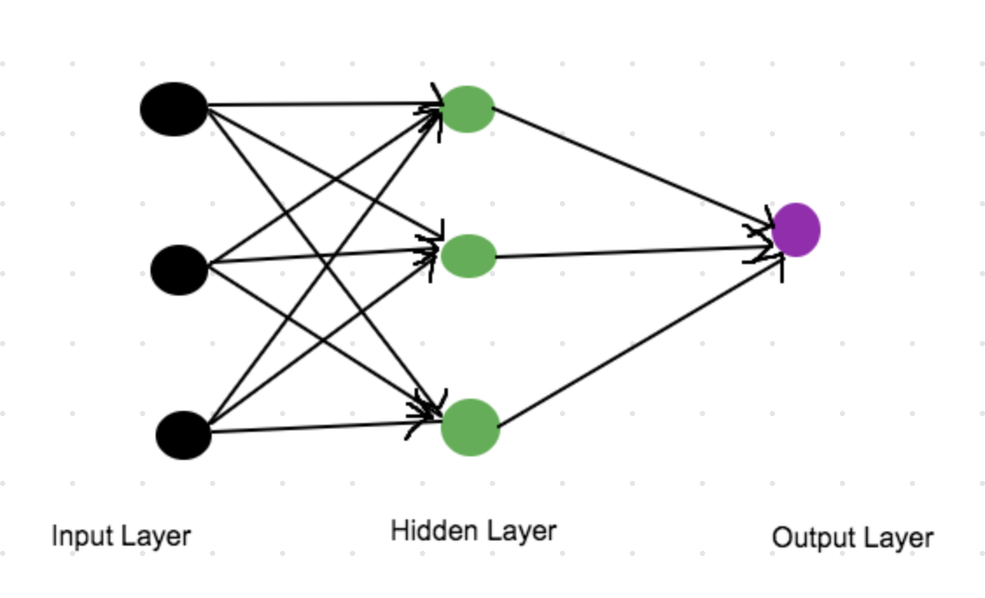
Neural Network Architecture
The term neural network architecture refers to the arrangement of neurons into layers and the connection patterns between layers, activation functions, and learning methods.
The neural network model and the architecture of a neural network determine how a network transforms its input into an output.

Slide 6

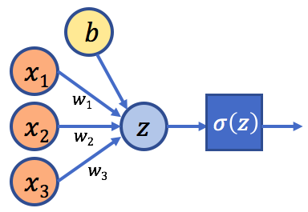
Logistic Regression Neural Network The Sigmoid Function
The sigmoid activation function converts its input to a value between 0 and 1 — as z increases towards positive infinity the output gets closer to 1, and as z decreases towards negative infinity the output gets closer to 0.
Logistic regression is a binary classification method.
For example, after being trained on images of cats and dogs and then being given a picture that it has never seen before of a cat (y=0) or a dog (y=1), can the machine predict the correct type?
As we’ll see, even a simple algorithm like logistic regression can do surprisingly well.

Slide 7
Loss Function and Cost Function
Loss function helps in optimizing the parameters of the neural networks. ... The loss is calculated using loss function by matching the target(actual) value and predicted value by a neural network. Then we use the gradient descent method to update the weights of the neural network such that the loss is minimized.
A cost function is a measure of "how good" a neural network did with respect to it's given training sample and the expected output. It also may depend on variables such as weights and biases

Slide 8
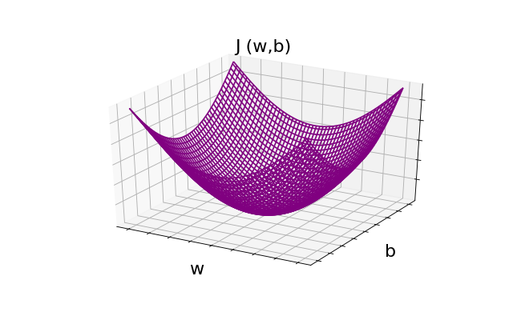
Gradient Descent
Gradient descent is the essence of the learning process — through it the machine learns what values of weights and biases minimize the cost function. It does this by iteratively comparing its predicted output for a set of data to the true output in a process called training.
One of the reasons we use this cost function for logistic regression is that it’s a convex function with a single global optimum.
Imagine rolling a ball down the bowl-shaped function — it would settle at the bottom; similarly, to find the minimum of the cost function, we need to get to the lowest point. To do that, we can start from anywhere on the function and iteratively move down in the direction of the steepest slope, adjusting the values of w and b that lead us to the minimum.

Slide 9
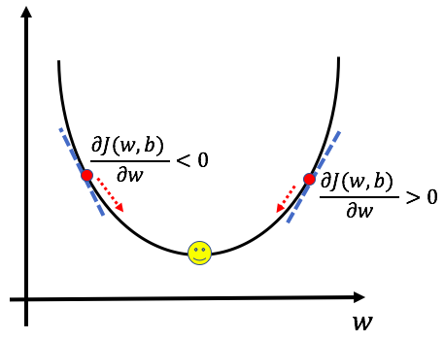
Gradient Descent Illustration

Slide 10
Training a Model
An athlete can perform at a high level because of her extensive training — through repeated iterations and adjustments along the way, she’s able to figure out what works and what doesn’t. In supervised machine learning, given a set of inputs and output labels, a model learns the best combination of weights and biases that minimizes the overall cost function.
The learning process comprises of Forward Propagation and Backward Propagation.

Slide 11
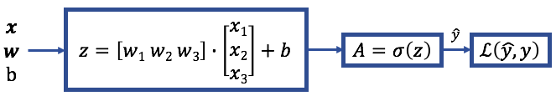
Forward Propagation
First, weight and bias values are propagated forward through the model to arrive at a predicted output.
At each neuron/node, the linear combination of the inputs is then multiplied by an activation function as described above— the sigmoid function in our example.
This process by which weights and biases are propagated from inputs to output is called forward propagation. After arriving at the predicted output, the loss for the training example is calculated.

Slide 12
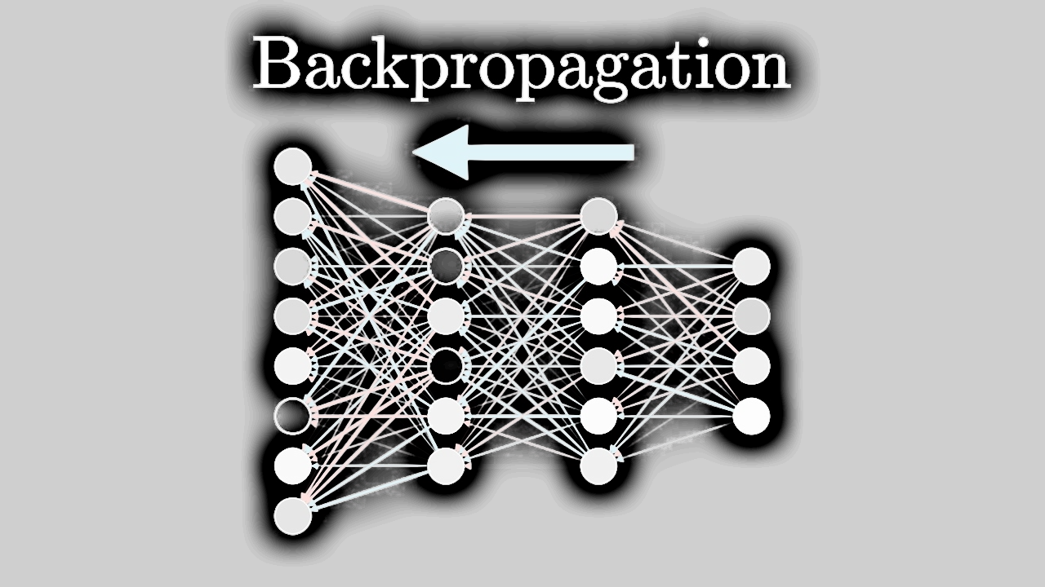
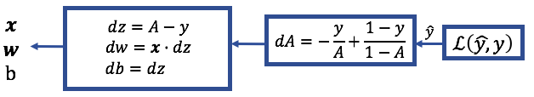
Backward Propagation
We previously saw how the gradient descent algorithm allows us to find the minimum of the cost function. Back propagation is the process of calculating the partial derivatives from the loss function back to the inputs, thereby updating the values of w and b that lead us to the minimum.
A: Activation Function

Slide 13
Prediction
After finding the optimal values of w and b after a certain number of iterations, the next step is to use those values to calculate the final predicted output.
The sigmoid activation function yields a probability distribution between 0 and 1 — for logistic regression we need to convert that to a discrete value of either 0 or 1.
To do so, we’ll apply a threshold value to the output, 0.5 for instance, so that probability values 0.5 or above result in a predicted output value of 1, whereas probability values less than 0.5 result in a predicted output value of 0.
After predicting the final output, we need to see how well the model did. One way to evaluate classification models is by defining a term called accuracy.

Slide 14
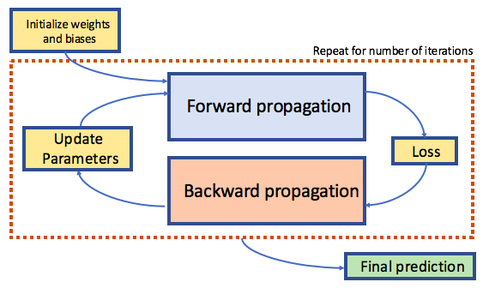
The figure below summarizes the iterative process through which the machine learns:

Slide 15
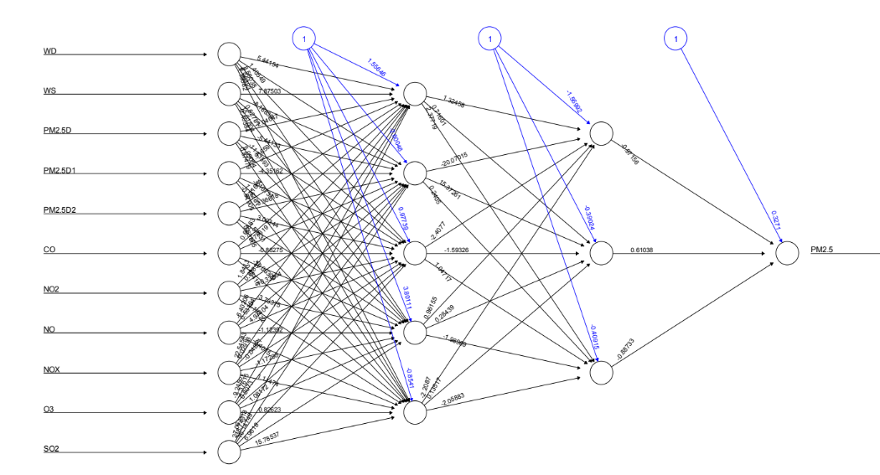
Example of a Neural Network Architecture with Weights and Biases Mentioned

